Slide 1
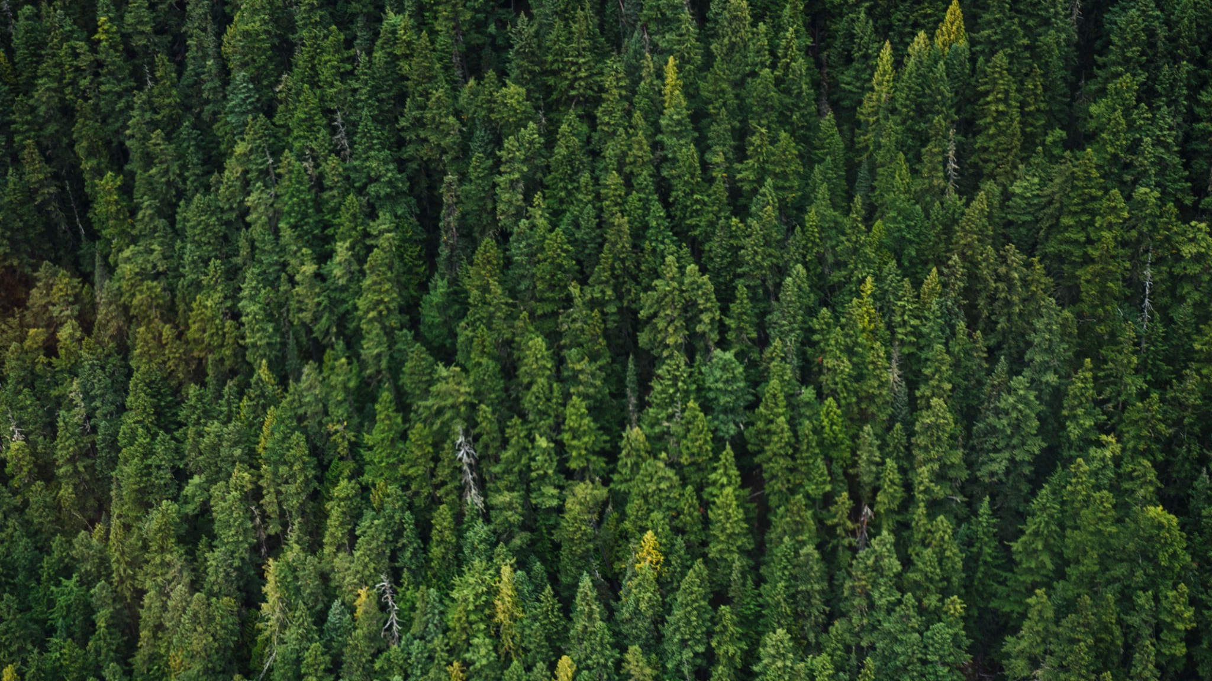
Phytora
By Team 3 SALAAR
SPRINT 3

Slide 2
Agenda
Section
12
Agenda
Team Member Roles and Responsibilities
Project Description
Improvements Made from Professor Feedback
Team Working Agreement
Personas
Minimal Viable Product (MVP)
Technologies
Algorithms
Diagrams
Sprint 2 Recap
Product Backlog
Sprint 3 Backlog
Sprint 3 Test Cases
Stories Completed (Sprint 3)
Stories Not Completed (Sprint 3 Carry Over)
Metrics
Retrospective
Project Demo - Sprint 3
GitHub Link & Live Application Demo

Slide 3
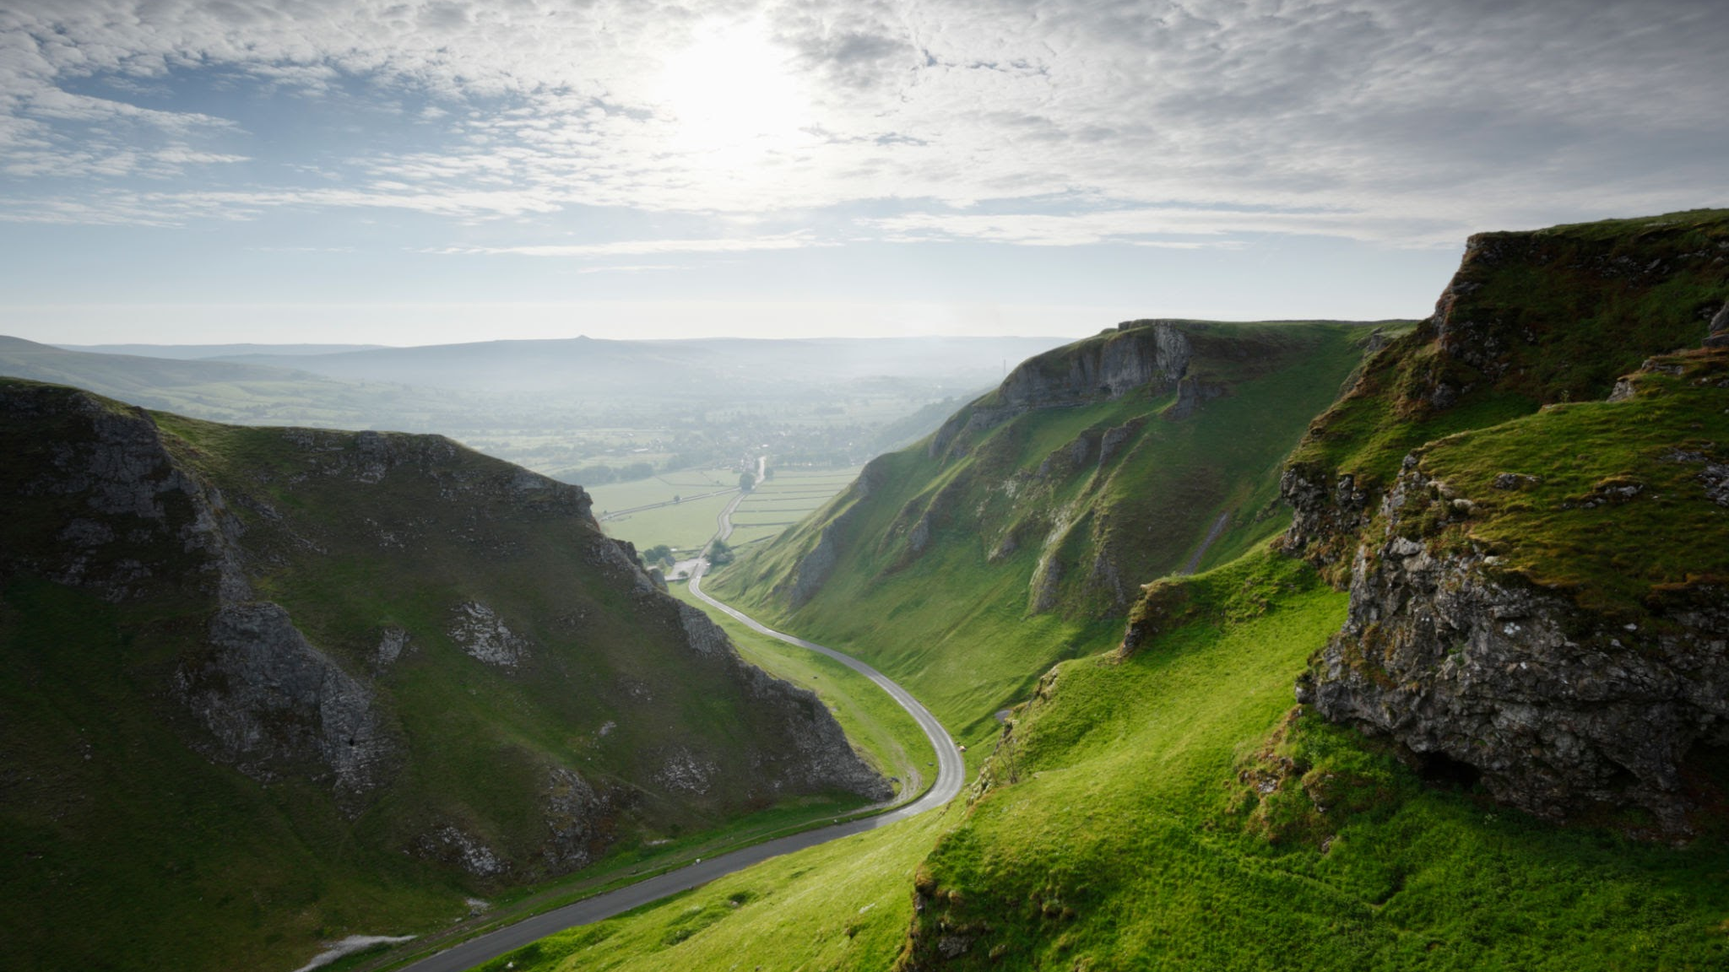
Team Member Roles and Responsibilities
01

Slide 4

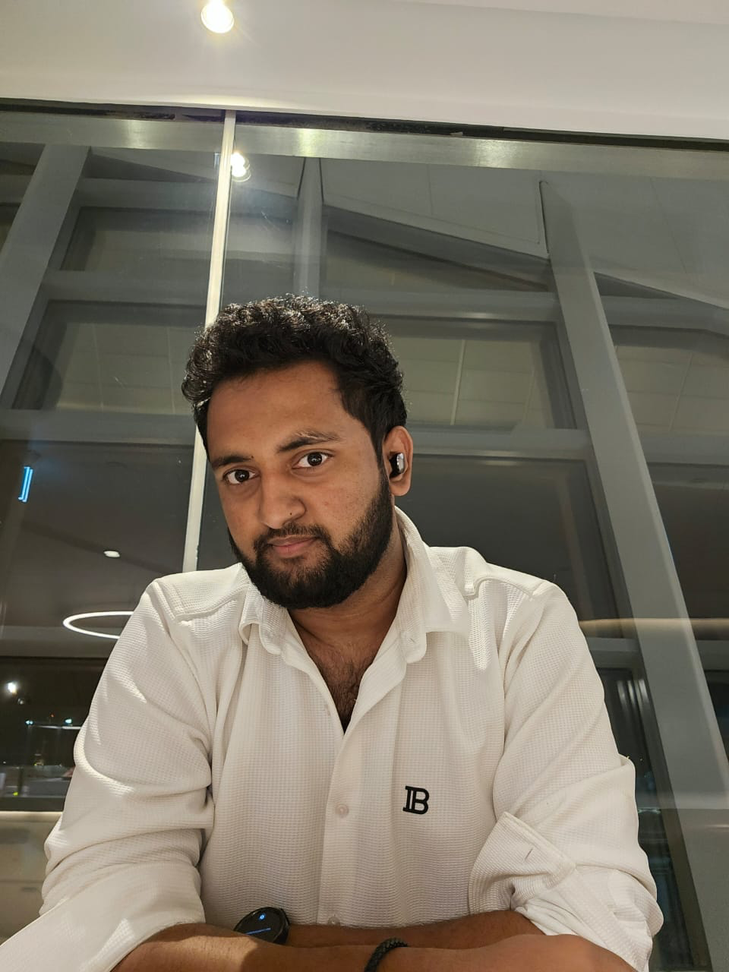
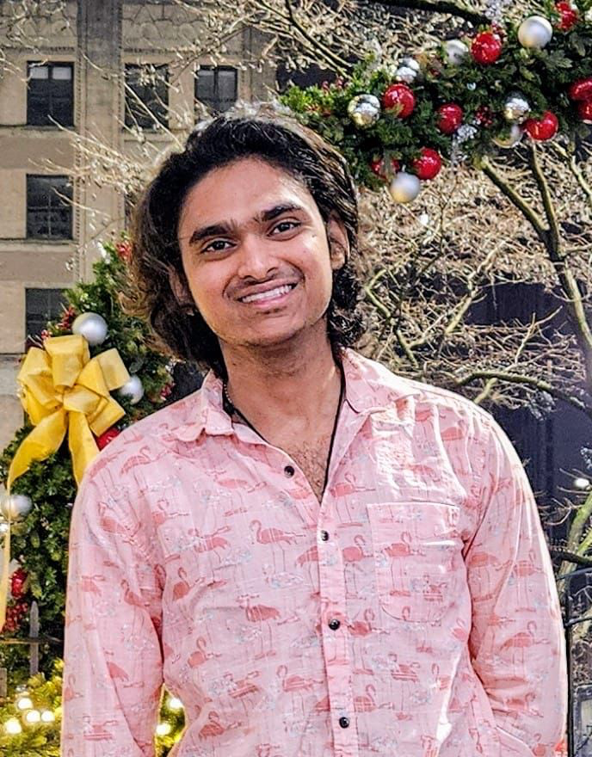
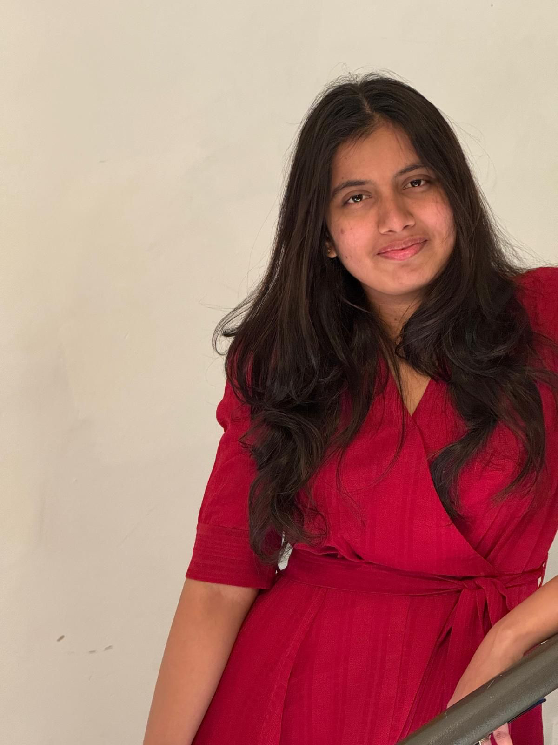
Team Members
Machine Learning Engineer
Backend Developer
Backend Developer
Frontend Developer
Manoj Kumar Reddy Mule
Krishna Kishore Varma Kalidindi
Gopi Krishna Bhookya
Saipriya Rampudi

Slide 5
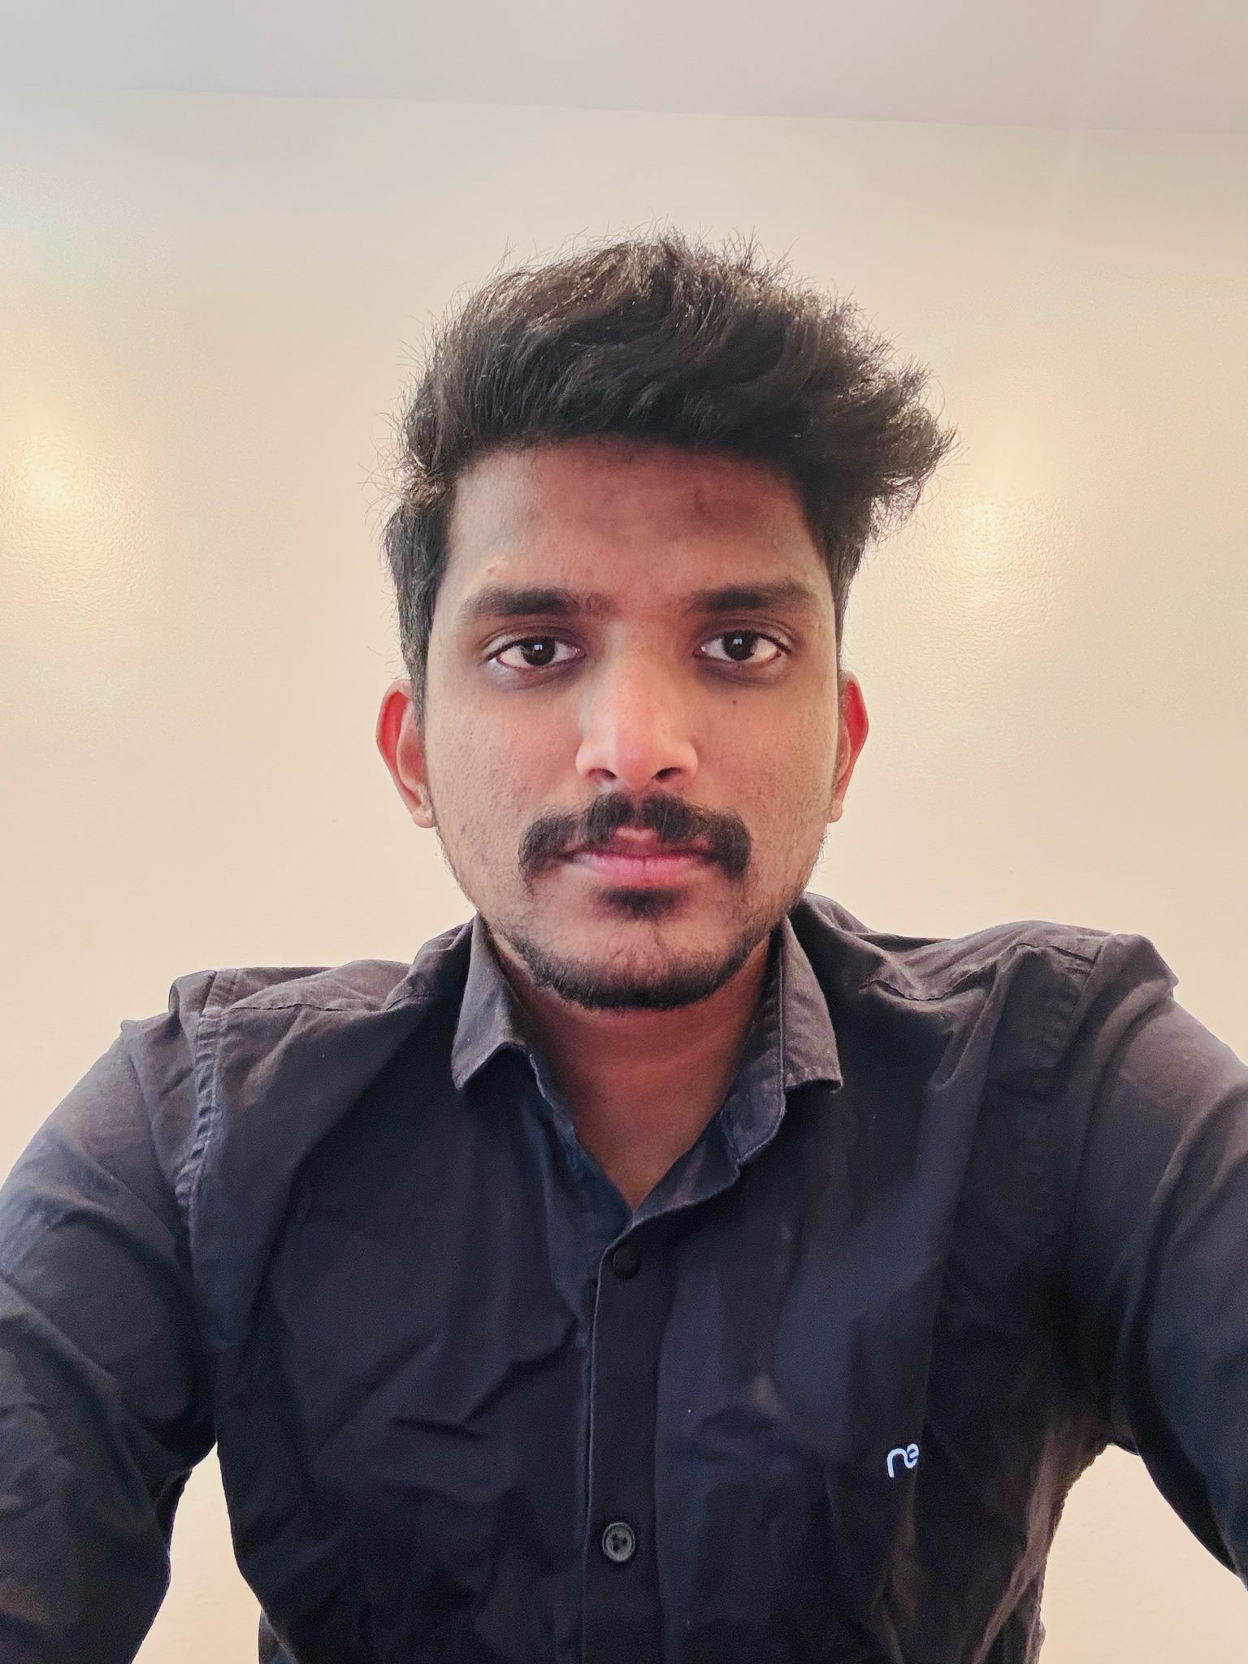
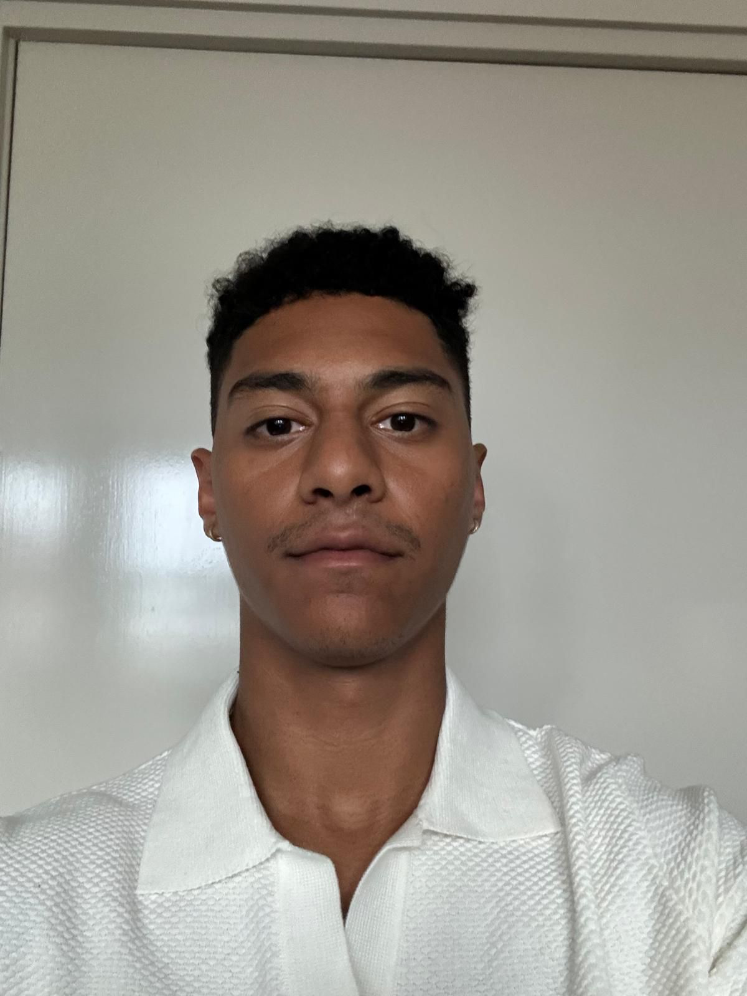
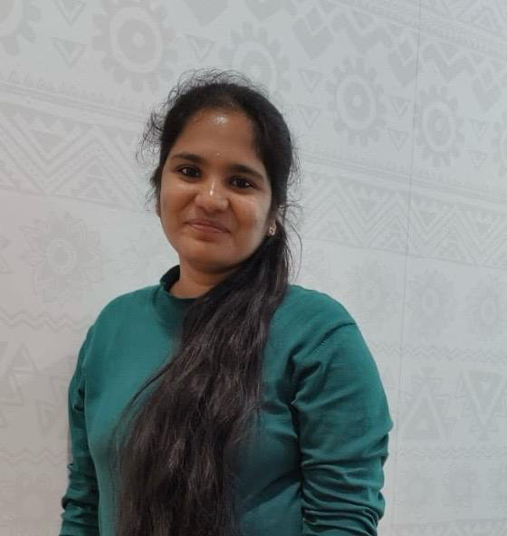
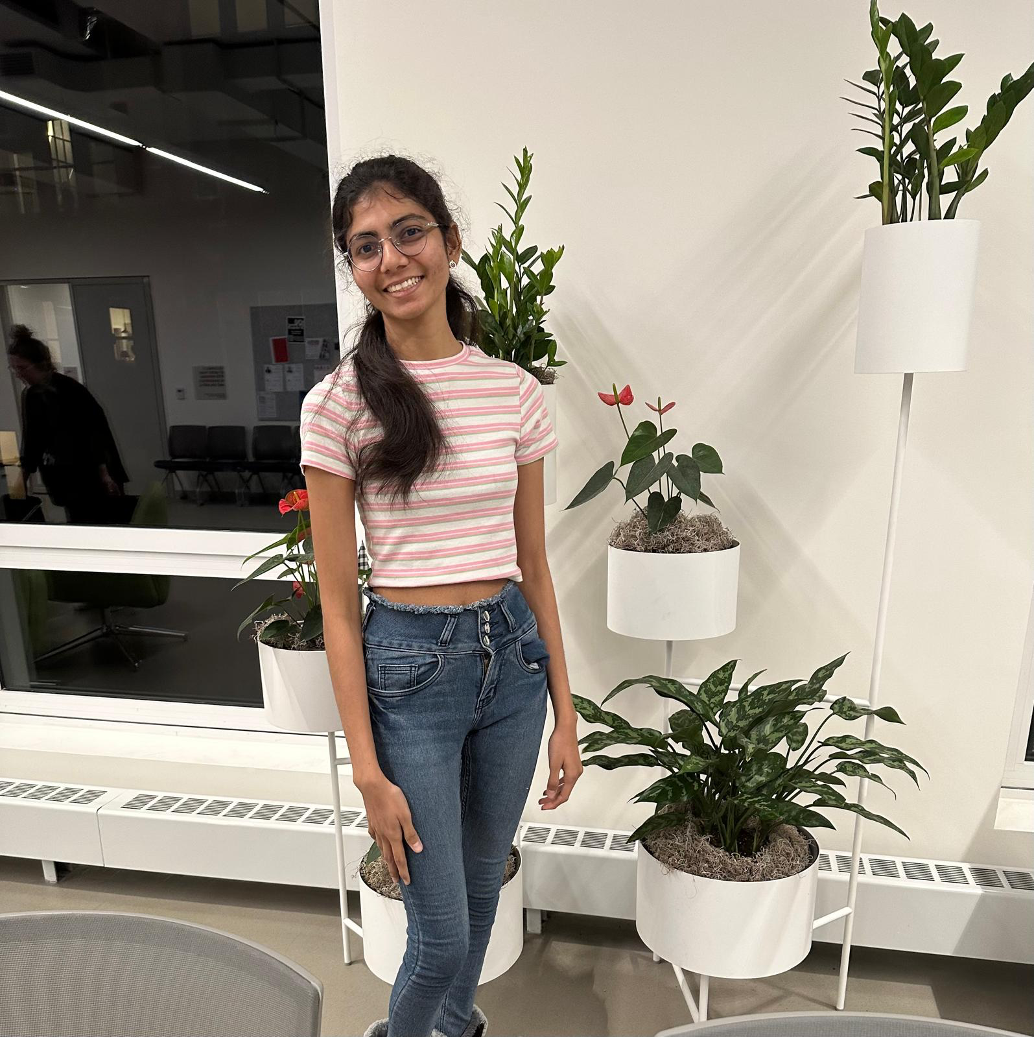
Team Members
Machine Learning Engineer
Frontend Developer
Backend Developer & QA
Frontend Developer
Naga Karthik Potru
Paul Morales
Nikitha Arpula
Nagalakshmi Narra

Slide 6
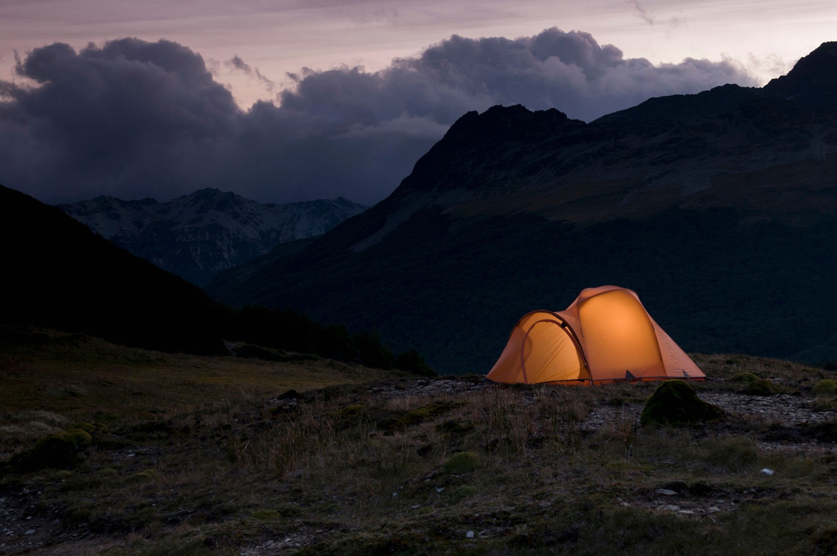
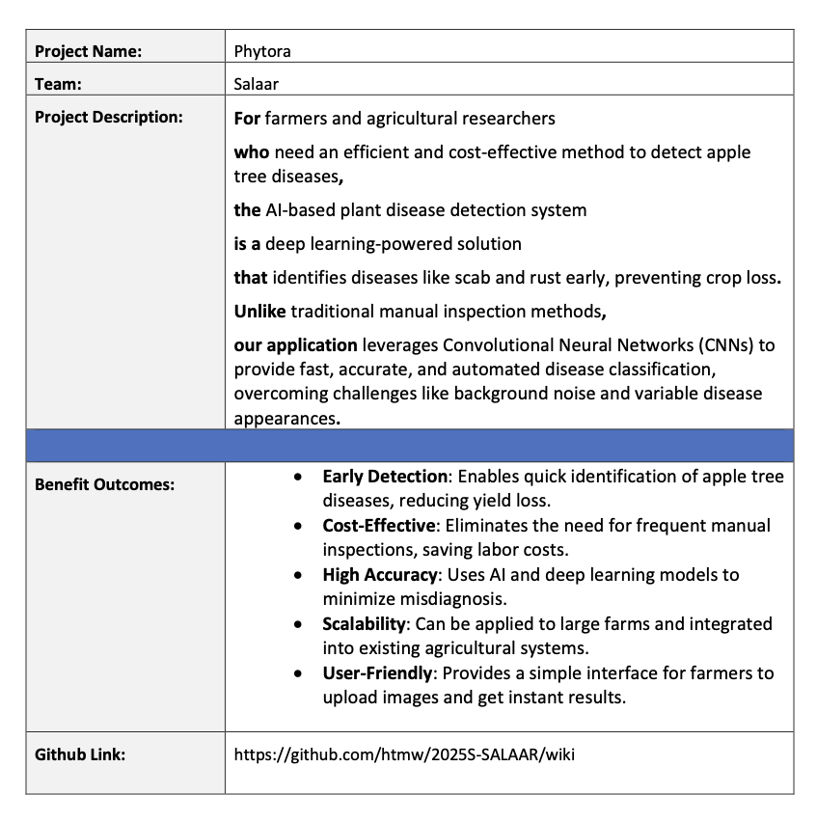
2. Project Description

Slide 7
3. Improvements

Slide 8
Improvements
Fixing issue with the wikipages, making the links work.
Fixing the diagrams
Adding Total Story Points for completed slide
Adding API Slide

Slide 9
Team Working Agreement
04

Slide 10
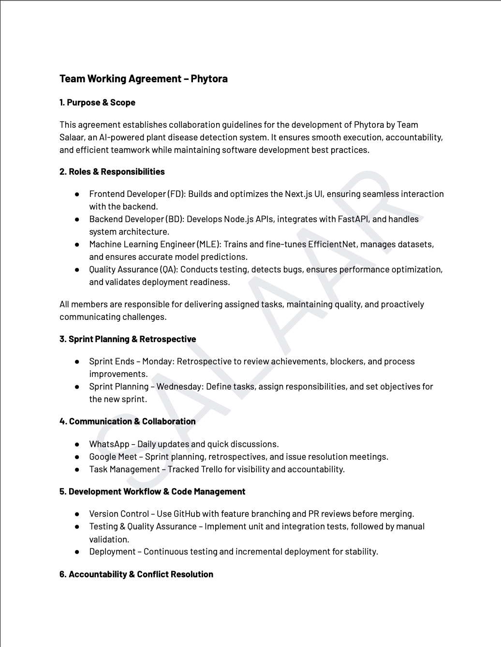
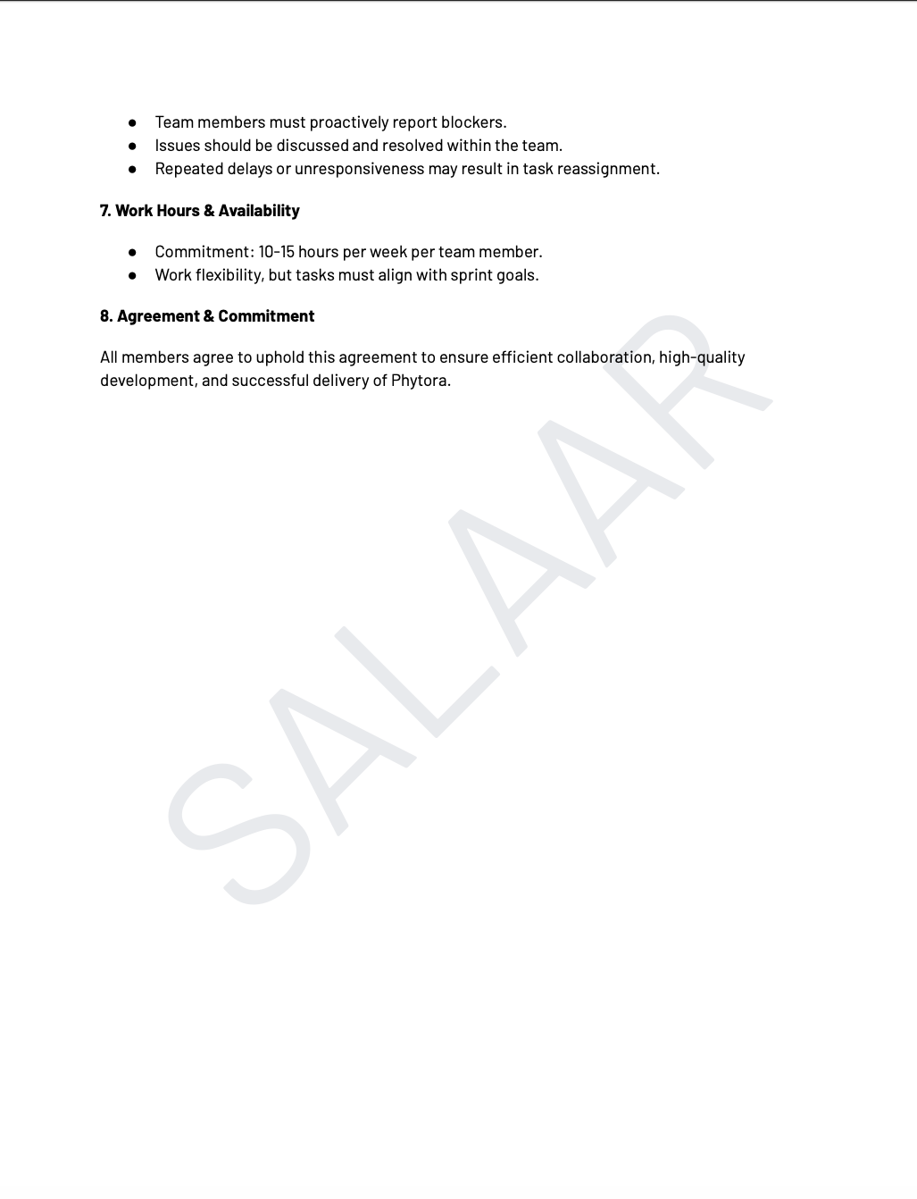

Slide 11
Personas
05

Slide 12
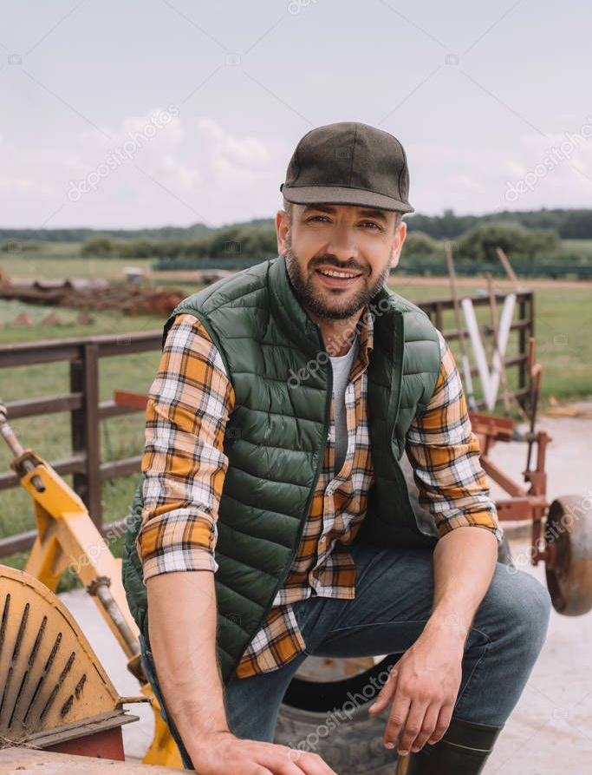
Farmer – John Carter
Age: 45
Occupation: Apple Orchard Owner
Location: Washington, USA
Technology Proficiency: Low to Moderate
Farming Experience: 20+ years
Pain Points:
Relies on manual disease inspection, which is time-consuming and error-prone.
Finds it hard to differentiate between early-stage symptoms of apple scab and rust.
High costs for hiring agricultural experts and consultants.
Crop losses due to late detection of infections, leading to lower profits.
Needs & Expectations:
A mobile-friendly app where he can take a picture of infected leaves and receive instant results.
An AI-driven advisory system suggesting treatment solutions for different disease stages.
Offline functionality, since farms often have poor internet connectivity.
A cost-effective solution that doesn’t require expensive hardware.
How Our Product Helps:
Automated disease detection reduces guesswork and ensures timely intervention.
Provides step-by-step guidance on disease management, reducing dependency on external experts.
Saves time and labor costs, increasing farm productivity and yield.

Slide 13
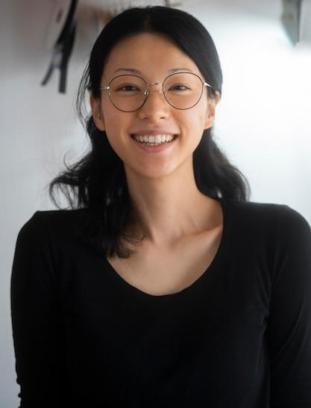
Agricultural Researcher – Dr. Emmy Zhao
Age: 38
Occupation: Plant Pathologist & Researcher
Location: California, USA
Technology Proficiency: High
Research Focus: AI-based plant disease prediction, crop disease resistance
Pain Points:
Needs large, high-quality datasets to improve disease classification models.
Variability in disease symptoms (color, shape, size) makes model training challenging.
Lack of real-time field data for studying disease spread patterns.
Difficulty in integrating AI-based tools with existing agricultural research systems.
Needs & Expectations:
Access to a labeled image dataset for improving AI accuracy.
A cloud-based dashboard with insights into disease occurrences across different regions.
Ability to contribute research data and collaborate with other scientists.
A customizable AI model that can be adapted for different crops and environmental conditions.
How Our Product Helps:
Provides real-time disease detection data, aiding in research and policy recommendations.
Offers a machine-learning training platform for researchers to refine detection algorithms.
Helps predict disease outbreaks, leading to more proactive agricultural strategies.

Slide 14
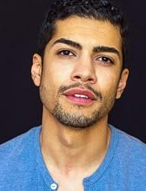
Agri-Tech Startup Founder – Michael Rodriguez
Age: 32
Occupation: CEO of a Smart Farming Startup
Location: Texas, USA
Technology Proficiency: High
Business Focus: AI-driven farm automation, precision agriculture
Pain Points:
Farmers are hesitant to adopt AI-based solutions due to trust issues and cost concerns.
Needs a scalable AI model that can integrate with existing smart farming hardware.
Difficulty in monetizing AI-based agricultural solutions while keeping them affordable.
Requires accurate, real-world disease detection data to improve product effectiveness.
Needs & Expectations:
A lightweight AI model that can be embedded in farm drones and IoT devices.
A subscription-based business model that balances affordability and profitability.
Market validation data to demonstrate AI’s effectiveness in reducing crop losses.
A seamless API to integrate disease detection with smart irrigation and pesticide control systems.
How Our Product Helps:
Provides real-time analytics and reporting tools for farm management.
Enables precision agriculture, optimizing pesticide use and reducing costs.

Slide 15
Minimal Viable Product (MVP)
06

Slide 16
Minimal Viable Product
Image Upload
Farmers can upload apple leaf images directly into the application for disease analysis and classification.
Disease Detection
System analyzes the uploaded image and automatically identifies if the leaf is healthy or diseased.
AI Model Integration
Our MVP delivers the core capability — detecting apple leaf diseases from images using AI. It focuses only on essential features needed for farmers to quickly upload images and receive reliable disease identification.
The backend integrates a trained CNN model to detect and classify diseases like scab and rust accurately.
Instant Diagnosis
After analysis, the application displays the disease name and confidence score in real-time for the user.

Slide 17
Technologies
07

Slide 18








Technologies
Frontend: Next.js – Fast, scalable, and SEO-friendly UI.
Backend: Node.js & FastAPI – Efficient API handling and real-time processing.
Machine Learning: PyTorch – Deep learning for accurate disease detection.
Database: PostgreSQL – Reliable relational database for storing image data and results.
IDE/Development Tool: Visual Studio Code – Primary code editor used by the team.
Version Control: GitHub – For collaboration, versioning, and artifact storage.
Deployment: Vercel – Hosting the frontend with automatic deployment from GitHub.

Slide 19
Algorithms
08

Slide 20
Algorithms
Our system utilizes EfficientNet, a state-of-the-art CNN model, for highly accurate and optimized plant disease detection. EfficientNet balances speed and accuracy by scaling depth, width, and resolution efficiently. Transfer learning enhances performance, while FastAPI enables real-time predictions, ensuring fast, precise, and resource-efficient disease identification for farmers and researchers.

Slide 21
9. Diagrams

Slide 22
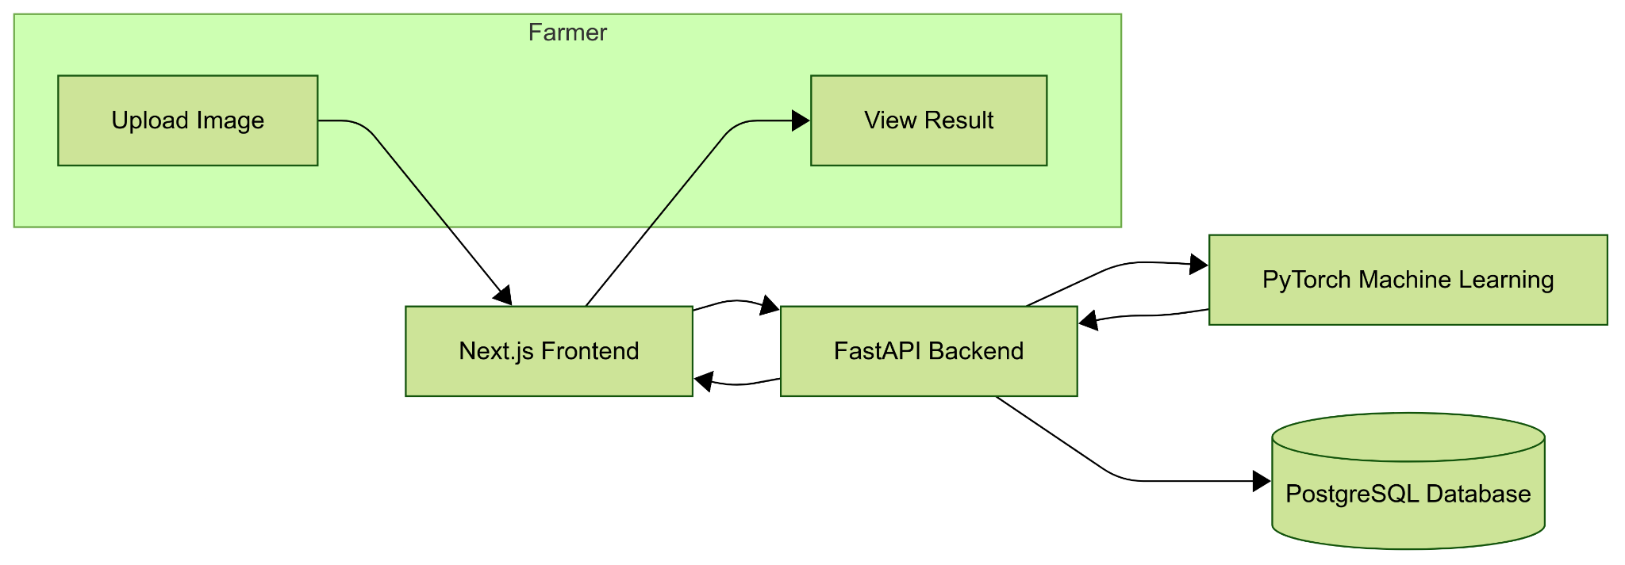
Architecture Diagram

Slide 23
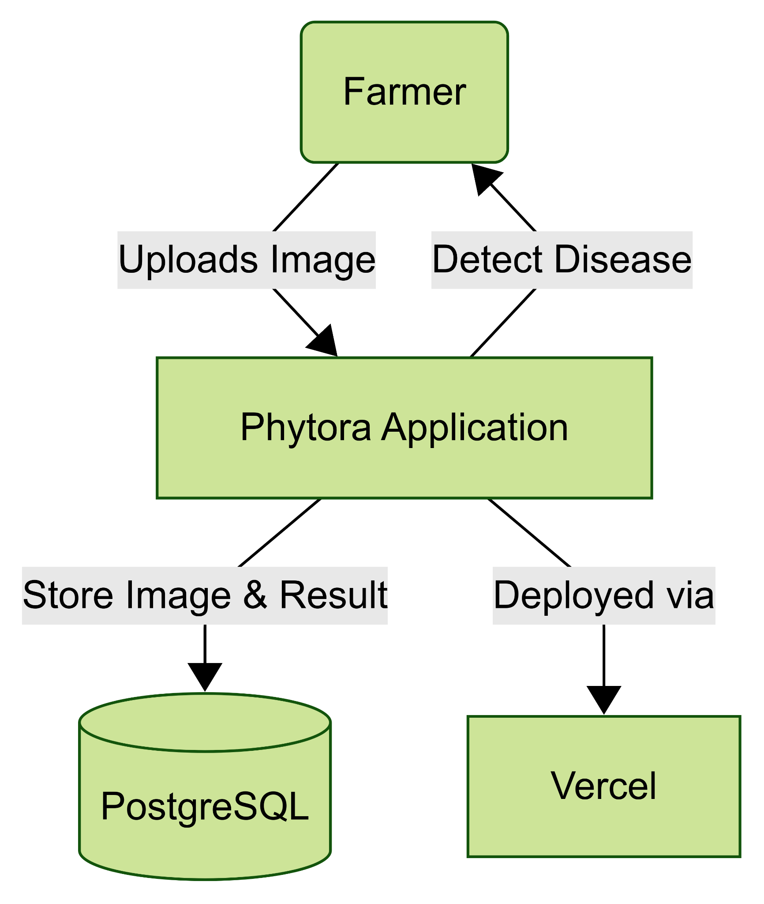
Context Diagram

Slide 24
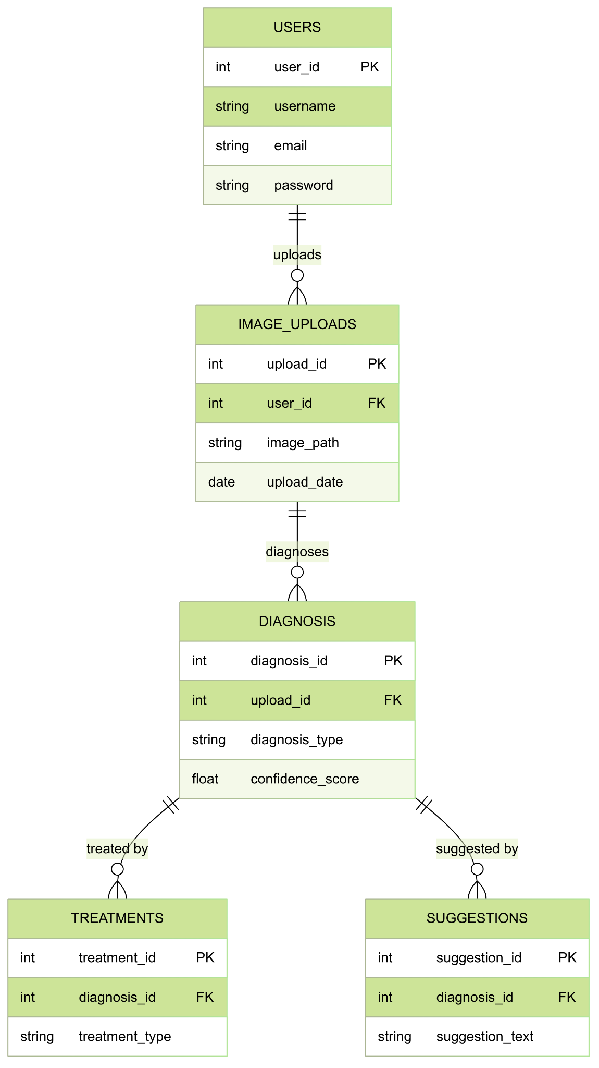
ER Diagram

Slide 25
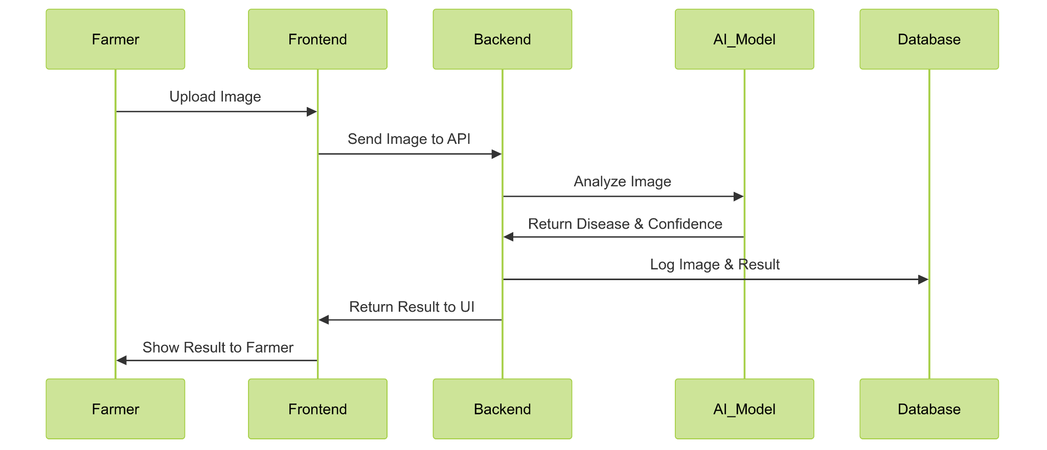
Sequence Diagram

Slide 26
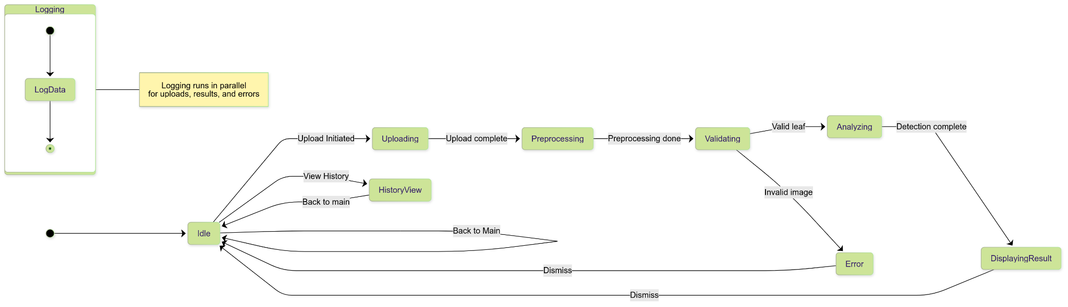
State Diagram

Slide 27
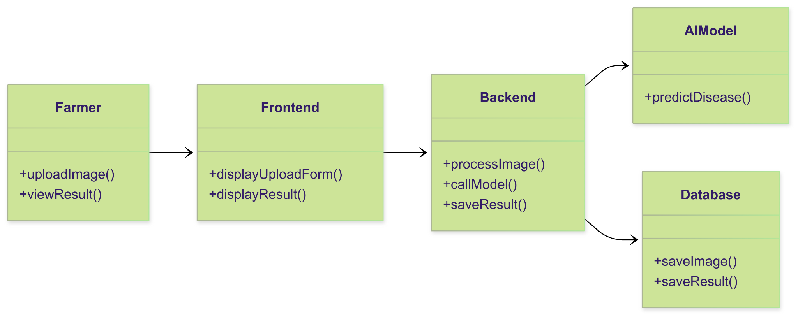
Class Diagram

Slide 28
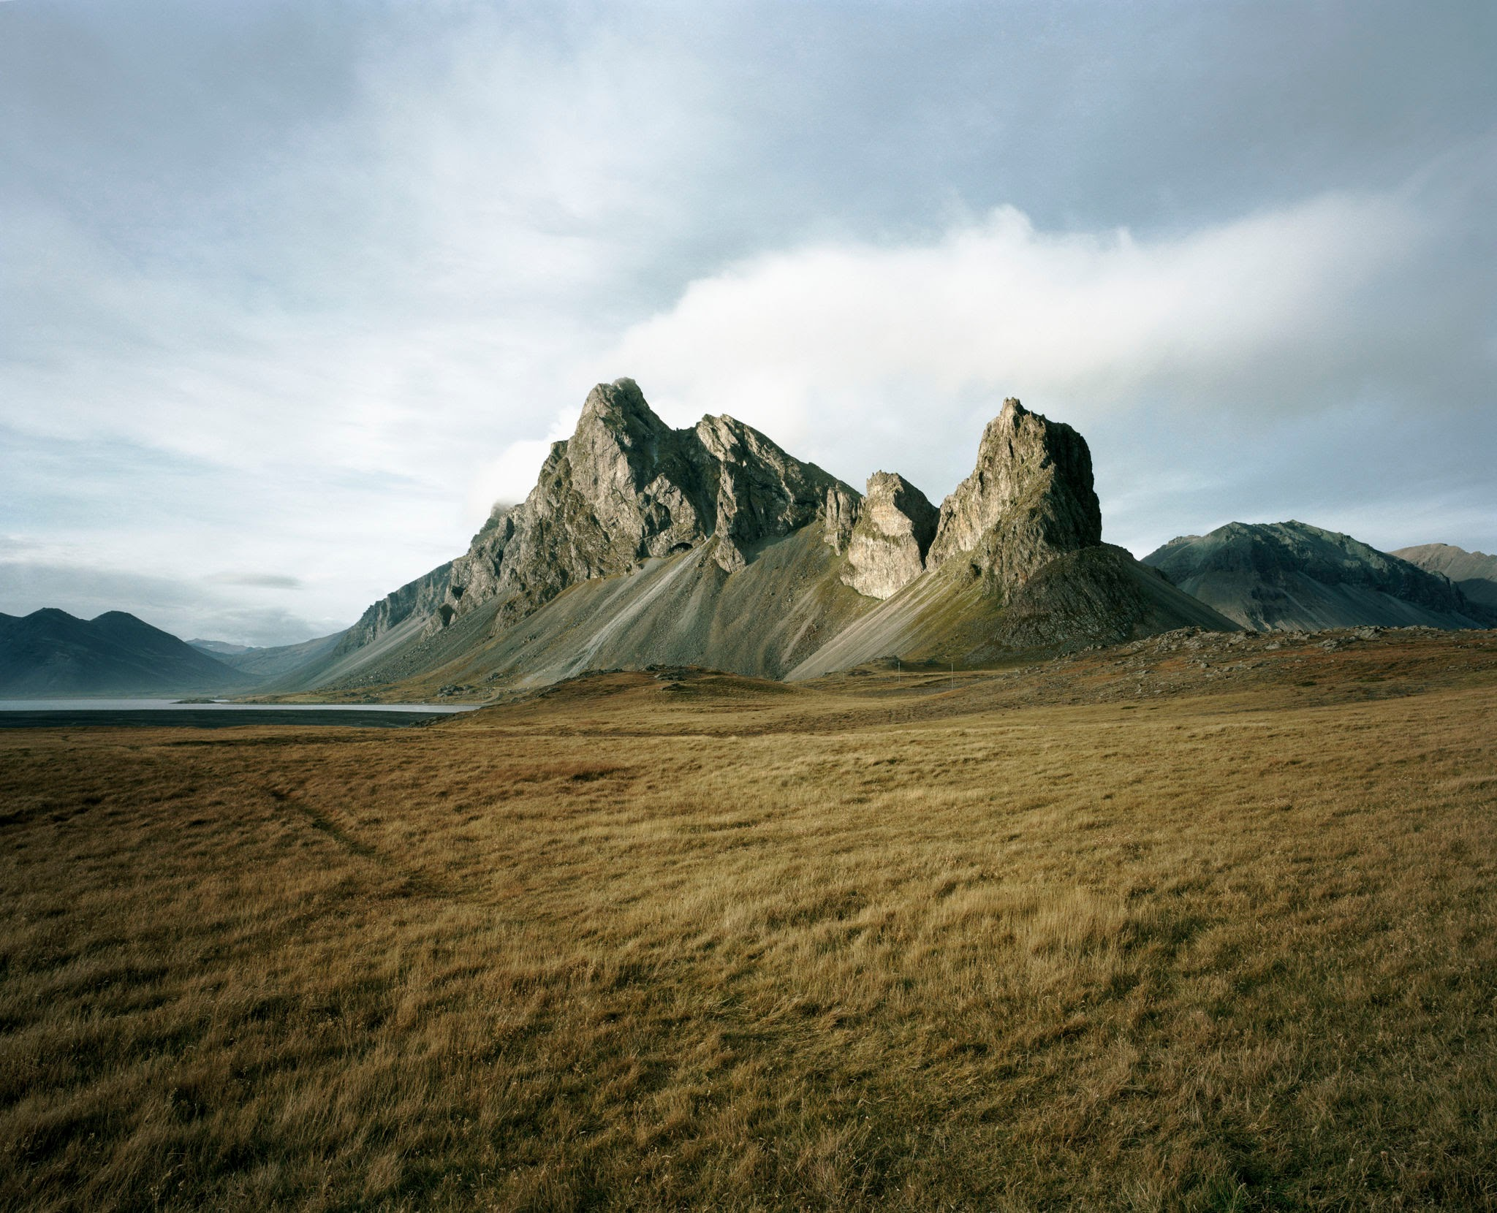
10.Recap
Section
12

Slide 29
Sprint 2 Recap
In Sprint 2, we made the system smarter by teaching it to tell the difference between scab and rust when a leaf is unhealthy. We also added confidence scores and basic advice, so farmers not only know what’s wrong but also what to do next.
We also tightened things up behind the scenes by making sure only real leaf images are accepted, and we added automated tests to keep the core features stable as we keep building.

Slide 30
11.Product Backlog
Section
12

Slide 31
Product Backlog
Sprint | ID | Story (User Story/Technical Story) | So That | Acceptance Criteria
Sprint 1 | US1.1 | As a farmer, I want to upload an image of my apple leaf | so that the system can analyze it for diseases | Image upload works from desktop and mobile; files saved to backend
Sprint 1 | US1.2 | As a farmer, I want the system to detect if my leaf is healthy or diseased | so that I can take action if needed | System returns "Healthy" or "Diseased" after image upload
Sprint 1 | TS1.1 | Pre-process images to remove noise and resize for AI model | so that the AI model receives consistent input for reliable detection | Images are resized and normalized before analysis
Sprint 1 | TS1.2 | Log uploaded images and results in PostgreSQL | so that we can track all scans for auditing and improvements | Each entry saved with timestamp, image URL, and result

Slide 32
Product Backlog
Sprint | ID | Story (User Story/Technical Story) | So That | Acceptance Criteria
Sprint 1 | TS1.3 | Set up CI/CD pipeline to deploy to Vercel | so that code changes automatically go live without manual deployment | Push to main triggers deployment to Vercel
Sprint 2 | US2.1 | As a farmer, I want the system to identify the specific disease if my leaf is unhealthy | so that I know exactly what’s wrong | System classifies between scab and rust
Sprint 2 | US2.2 | As a farmer, I want to see a confidence score with the result | so that I know how reliable the result is | Confidence score shown with each result
Sprint 2 | US2.3 | As a farmer, I want basic advice based on the detected disease | so that I know what to do next | Text advice (e.g., “Apply fungicide”) shown after detection

Slide 33
Product Backlog
Sprint | ID | Story (User Story/Technical Story) | So That | Acceptance Criteria
Sprint 2 | TS2.1 | Validate and reject non-leaf images | so that the system doesn’t waste resources analyzing invalid images | Non-leaf images trigger clear error message
Sprint 2 | TS2.2 | Add test cases for all core APIs | so that future changes do not break existing functionality | Each API (upload, detect, classify) has 3+ automated tests
Sprint 3 | US3.1 | As a farmer, I want to see past uploads and results | so that I can track disease history | History page shows past uploads with timestamps and results
Sprint 3 | US3.2 | As a farmer, I want to upload multiple images at once | so that I save time during scanning | Batch upload supports up to 5 images

Slide 34
Product Backlog
Sprint | ID | Story (User Story/Technical Story) | So That | Acceptance Criteria
Sprint 3 | US3.3 | As a farmer, I want the app to work well on mobile | so that I can use it directly in the field | App fully responsive on mobile browsers
Sprint 3 | TS3.1 | Optimize AI model for faster detection | so that the user doesn’t experience slow results | Inference time is less than 3 seconds per image
Sprint 3 | TS3.2 | Log errors to PostgreSQL when detection fails | so that developers can quickly identify and resolve issues | Each error log includes timestamp, image URL, and error message

Slide 35
12. Sprint 3 Backlog
Section
12

Slide 36
Sprint 3 Backlog
ID | Story (User Story/Technical Story) | So That | Acceptance Criteria | Story Points
US3.1 | As a farmer, I want to see past uploads and results | so that I can track disease history | History page shows past uploads with timestamps and results | 5
US3.2 | As a farmer, I want to upload multiple images at once | so that I save time during scanning | Batch upload supports up to 5 images | 3
US3.3 | As a farmer, I want the app to work well on mobile | so that I can use it directly in the field | App fully responsive on mobile browsers | 3
TS3.1 | Optimize AI model for faster detection | so that the user doesn’t experience slow results | Inference time is less than 3 seconds per image | 8
TS3.2 | Log errors to PostgreSQL when detection fails | so that developers can quickly identify and resolve issues | Each error log includes timestamp, image URL, and error message | 3

Slide 37
13. Sprint 3 Test Cases

Slide 38
Sprint 3 Test Cases
ID | Story | Test Case | Expected Result | Status
US3.1 | History Page | Upload leaf image and check history page | Upload appears in history with correct timestamp and result | Passed
US3.1 | History Page | Upload multiple images over time | All uploads correctly listed in history chronologically | Passed
US3.2 | Batch Upload | Upload 3 images at once | All 3 images are processed and results shown | Passed
US3.2 | Batch Upload | Try uploading 6 images | System shows error: “Maximum 5 images allowed” | Passed
US3.3 | Mobile Responsiveness | Open app on mobile browser | App layout adapts properly (no broken UI elements) | Passed
US3.3 | Mobile Responsiveness | Upload image from mobile | Upload and detection work smoothly on mobile | Passed
TS3.1 | Model Optimization | Upload leaf image | Detection result returns within 3 seconds | Passed

Slide 39
Sprint 3 Test Cases
ID | Story | Test Case | Expected Result | Status
TS3.1 | Model Optimization | Upload multiple images together | Each image processed under 3 seconds individually | Passed
TS3.2 | Error Logging | Trigger detection failure manually | Error logged in PostgreSQL with timestamp, image URL, message | Passed
TS3.2 | Error Logging | Simulate bad input to fail detection | Error entry created with all required fields in database | Passed

Slide 40
14. Sprint 3 Stories Completed

Slide 41
Sprint 3 Stories Completed
ID | Story | Status | Story Points
US3.1 | History Page | Completed | 5
US3.2 | Batch Upload | Completed | 3
US3.3 | Mobile Responsiveness | Completed | 3
TS3.1 | Model Optimization | Completed | 8
TS3.2 | Error Logging | Completed | 3
Total Story Points : 22

Slide 42
Metrics
15

Slide 43
Team Velocity
Total Story Points Completed: 22

Slide 44
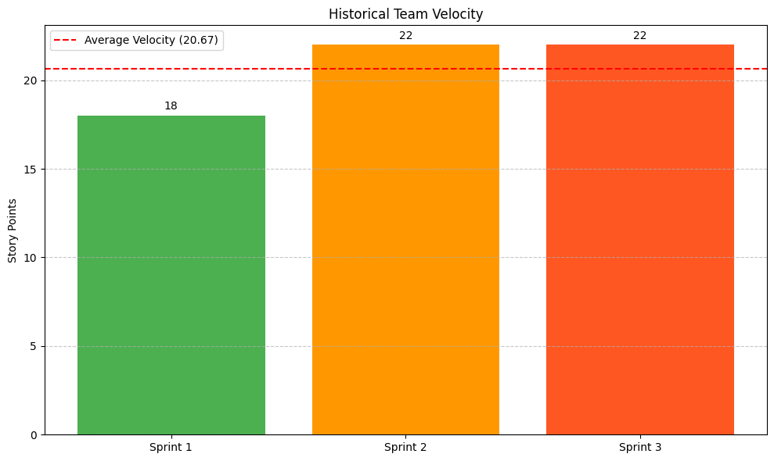
Historical Team Velocity

Slide 45
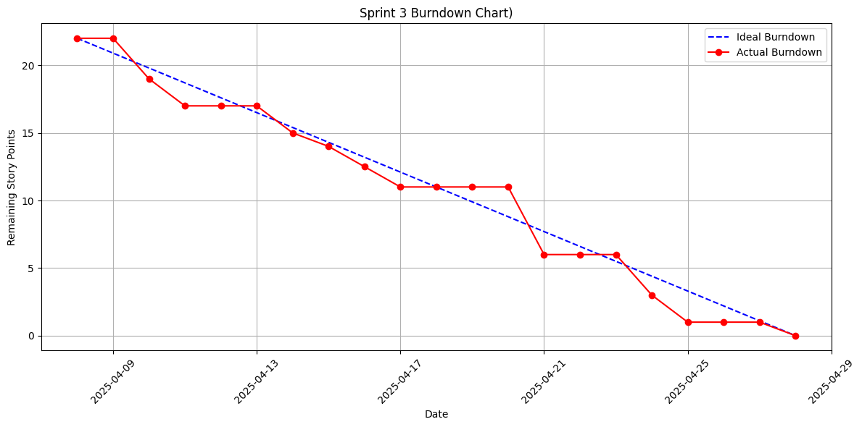
Burndown Chart Sprint 3

Slide 46
100%
Section
12
Completed/Committed Ratio Sprint 3
Committed Story Points: 22
Completed Story Points: 22
Completed/Committed Ratio: 22/22

Slide 47
100%
Section
12
Average Completed/Committed Ratio
Sprint 1: 18/18 → 100%
Sprint 2: 22/22 → 100%
Sprint 3: 22/22 → 100%
Average Completed/Committed Ratio: 100%

Slide 48
Retrospective
16

Slide 49
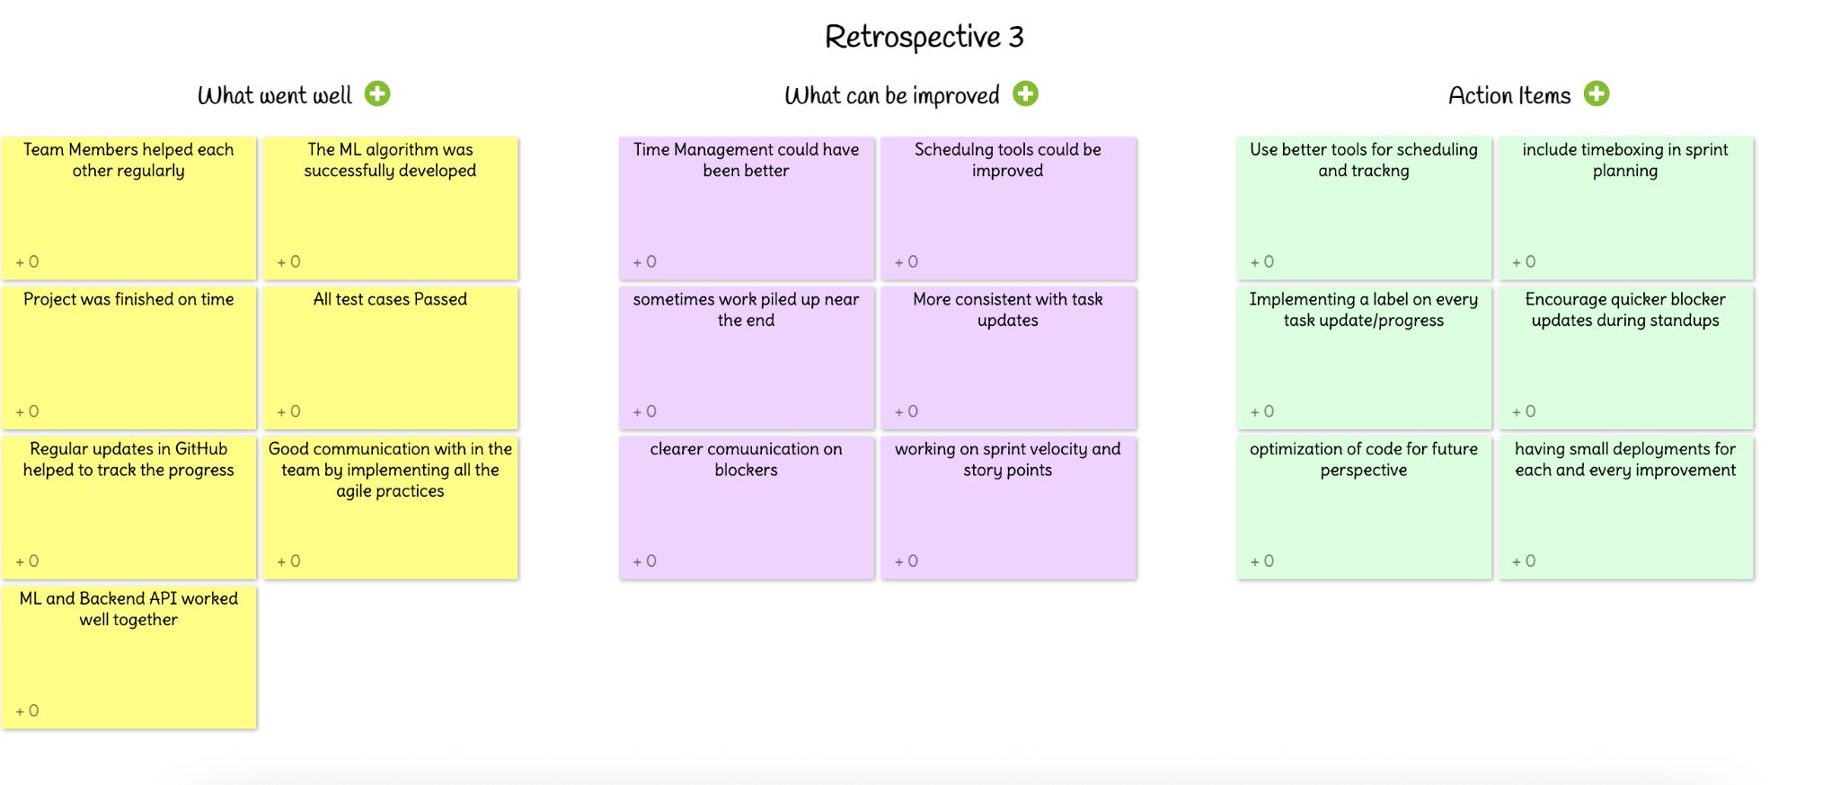

Slide 50
18. Project Demo

Slide 51
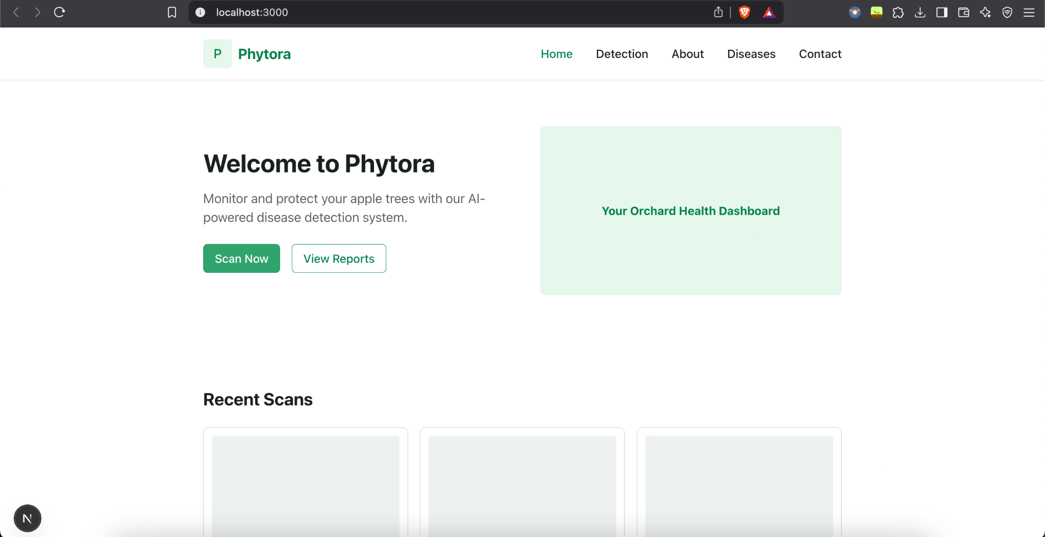
Screenshots of Application

Slide 52
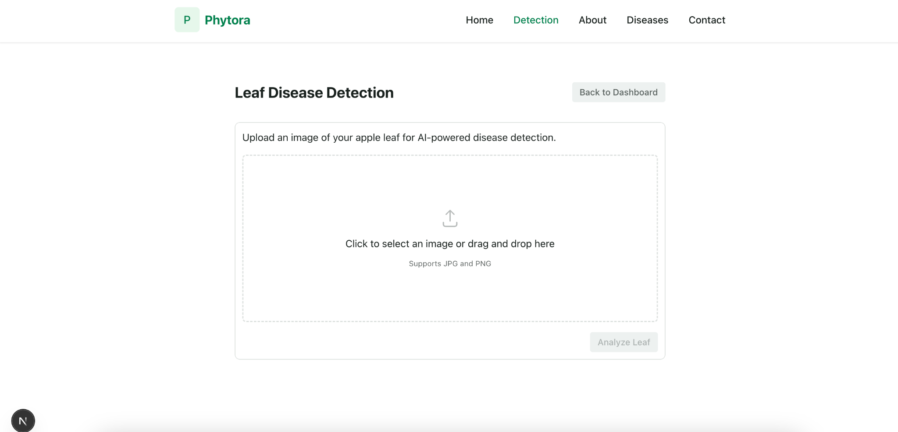
Screenshots of Application

Slide 53
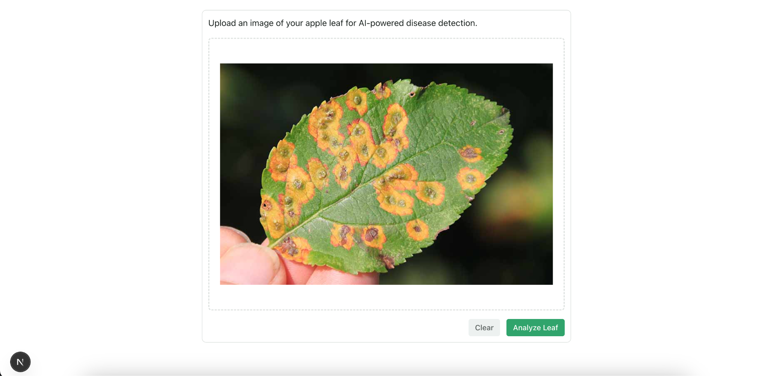
Screenshots of Application

Slide 54
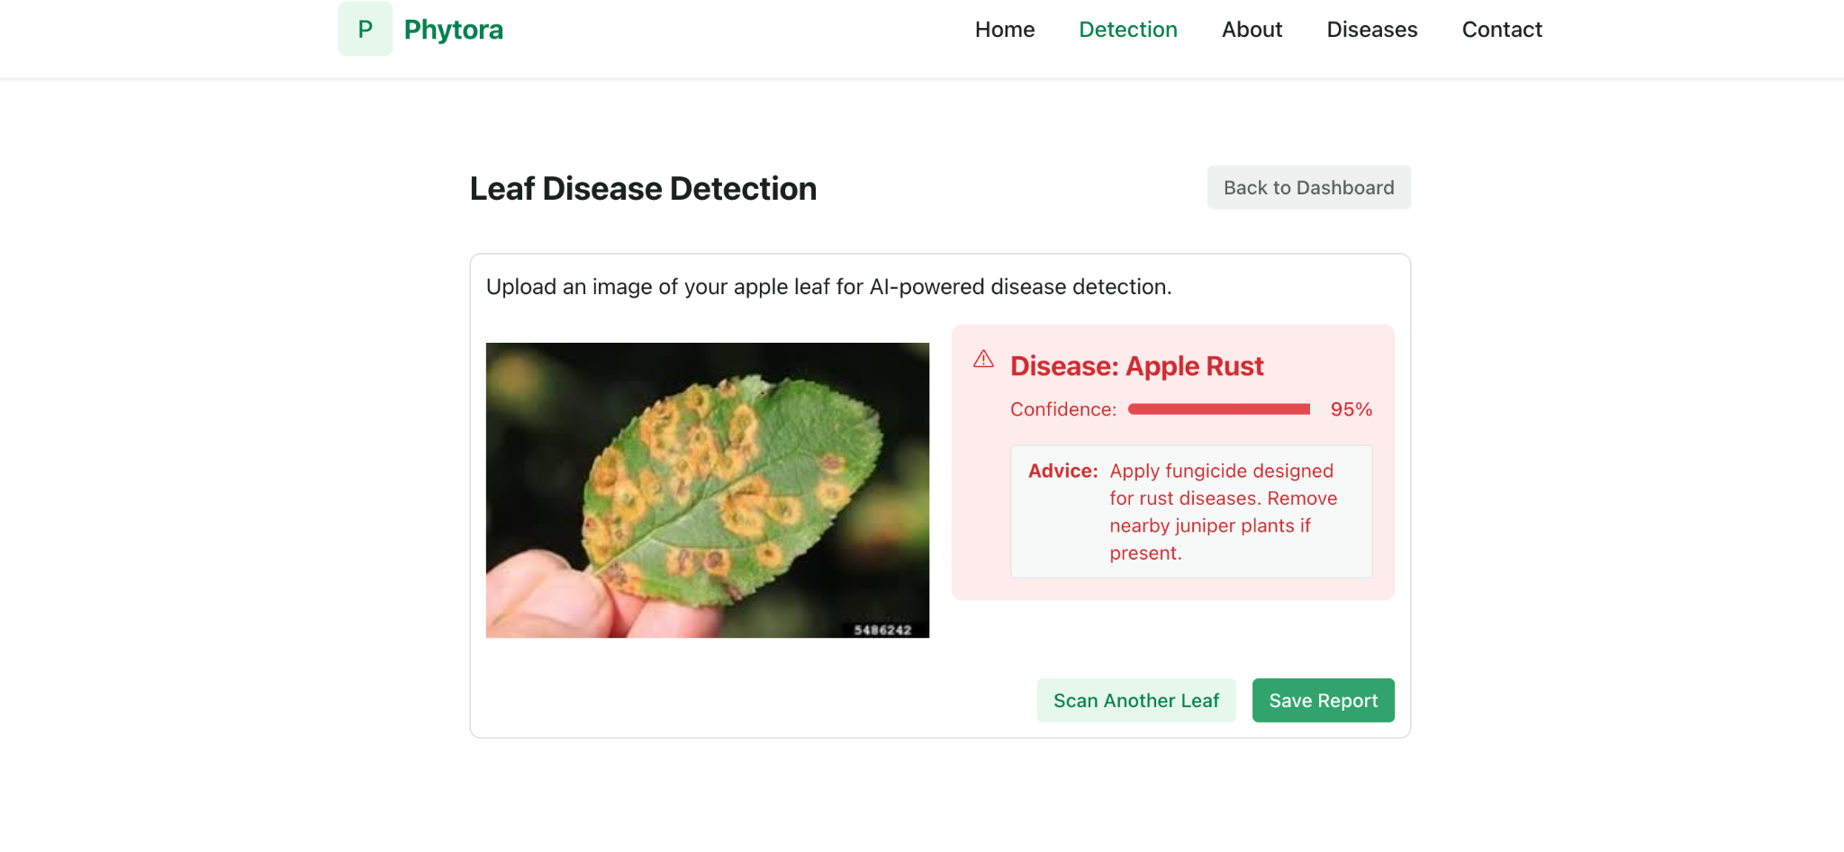
Screenshots of Application

Slide 55
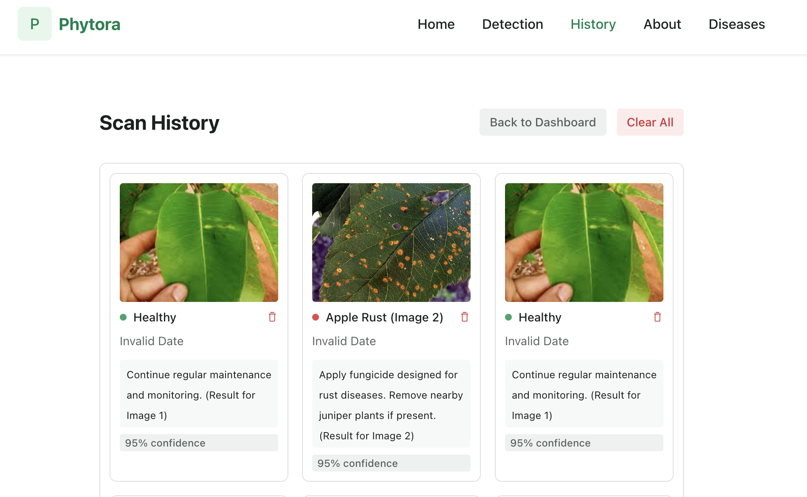
Screenshots of Application

Slide 56
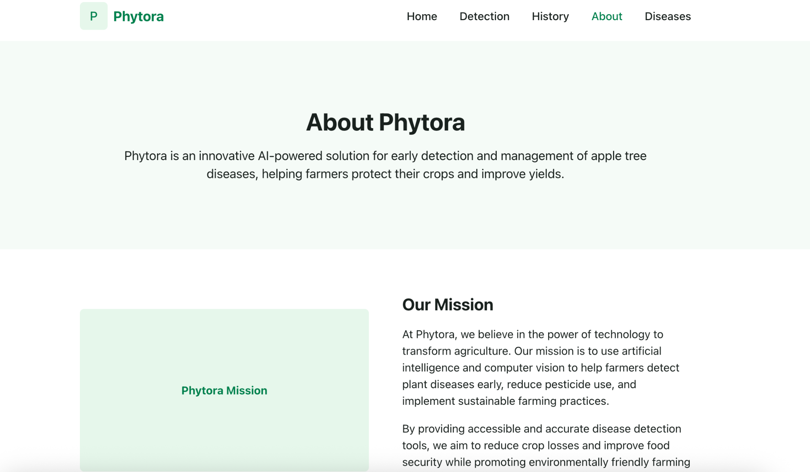
Screenshots of Application

Slide 57
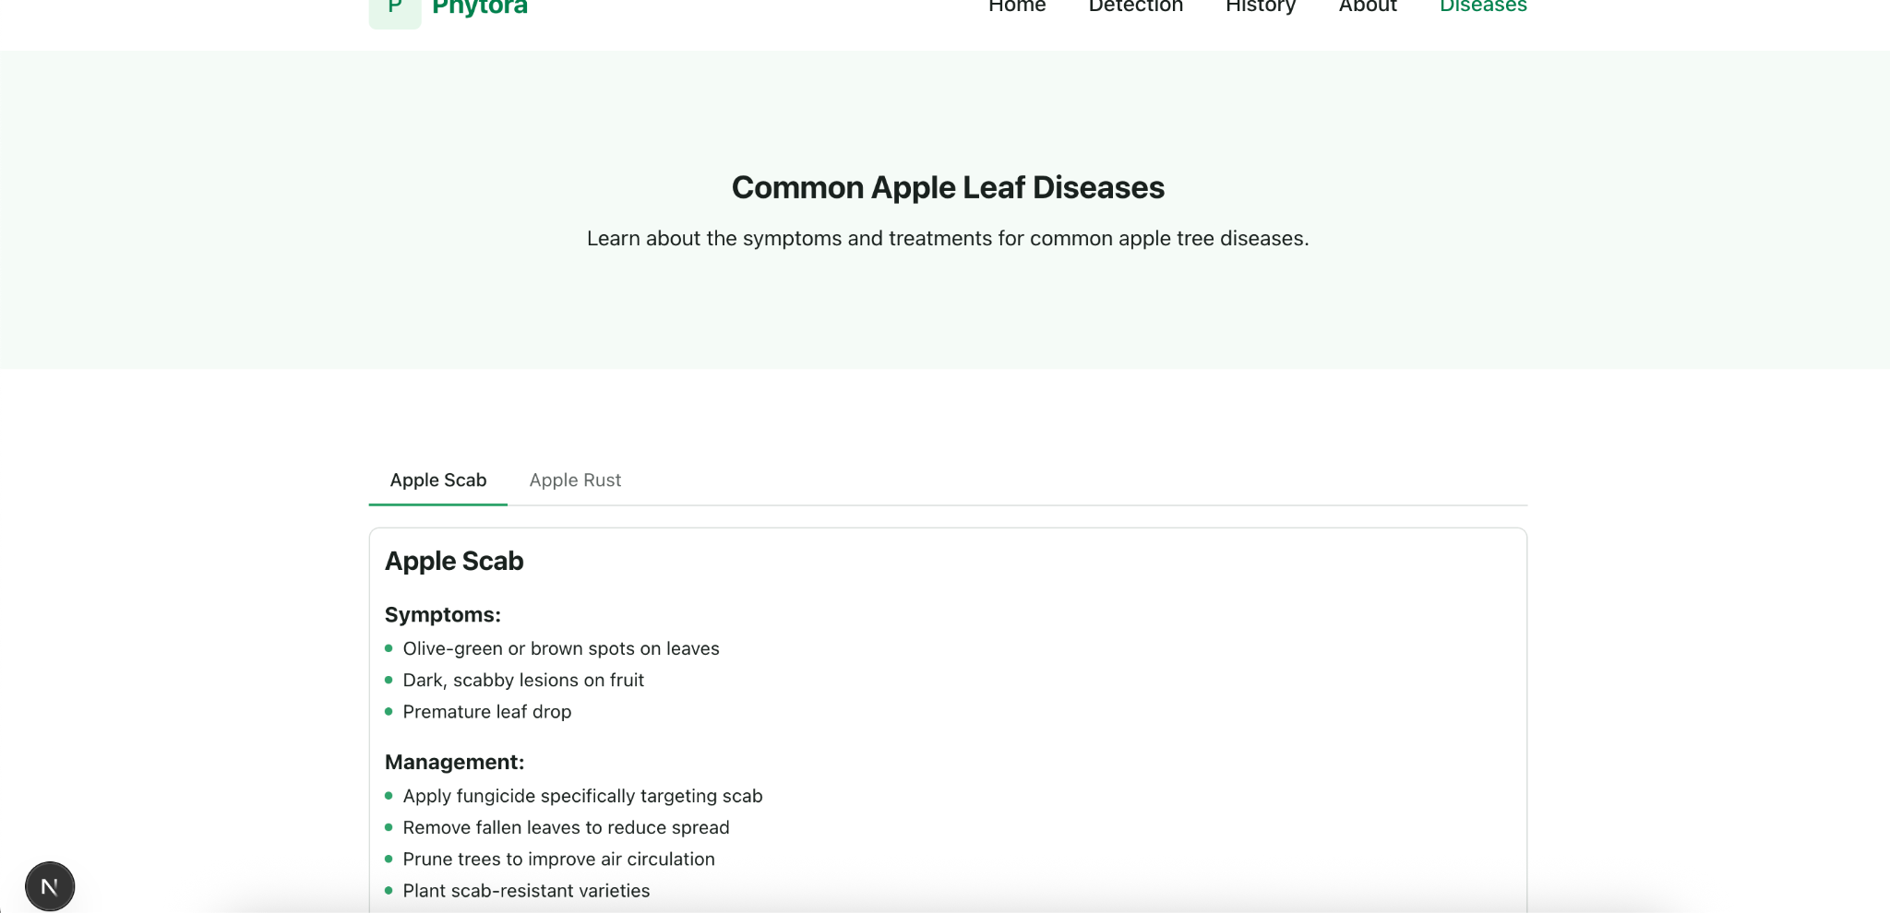
Screenshots of Application

Slide 58
API Slide
Purpose | Localhost URL | Example Request | Example Response
Upload image | POST http://localhost:3000/upload | Upload file(s) | { "upload_ids": [123] }
Run detection | POST http://localhost:3000/detect | { "upload_ids": [123] } | { "detections": [{"upload_id": 123, "status": "Unhealthy"}]}
Classify result | GET http://localhost:3000/classify?upload_id=123 | - | { "disease": "Scab", "confidence": 87 }
View history | GET http://localhost:3000/history | (Auth header) | { "history": [...]}
Get advice | GET http://localhost:3000/advice?disease=Rust | - | { "advice": "Use resistant plant varieties and apply fungicide." }
Validate image | POST http://localhost:3000/validate | Upload single image | { "is_leaf": true }

Slide 59

19. Wikipage
https://github.com/htmw/2025S-SALAAR/wiki

Slide 60
20. Demo

Slide 61
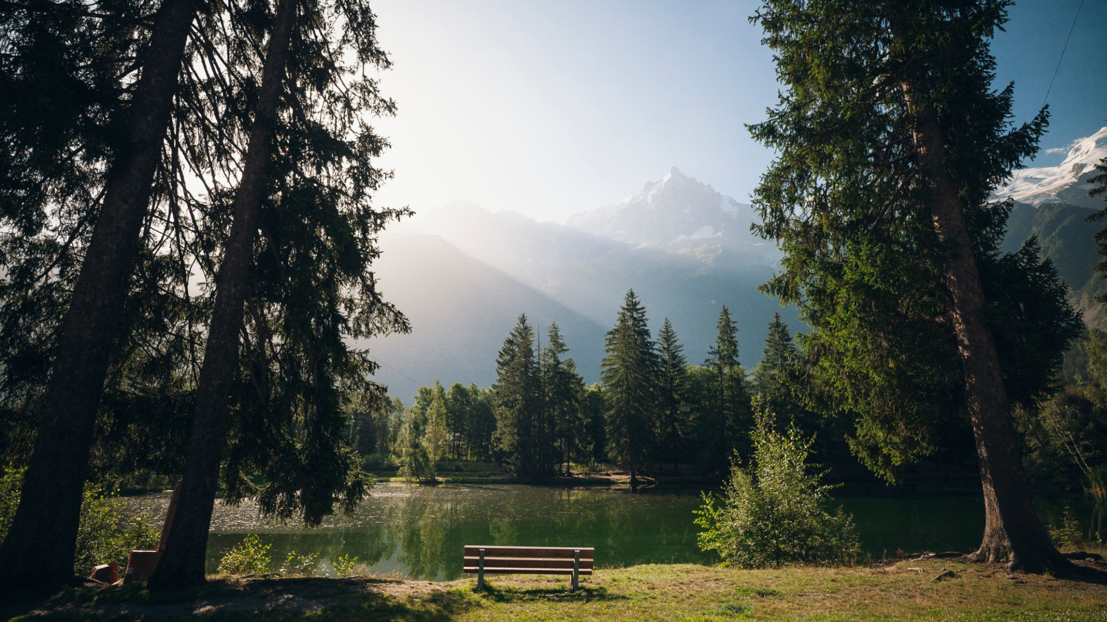
Thank
You

